Slide 1
Depth-Depth Plots for multivariate Data
Group 2
Akhilesh Chauhan
Apoorva Singh

Slide 2
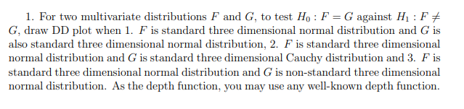
Problem Statement
HW4 Q1
^{[2]}

Slide 3
Data Depth
Data Depth is used to order data in higher dimensions
It is centre outward ordering
Represents closeness of our point to the data cloud
Highest depth for the point of symmetry
Various notions of data depth exist in literature
We’ll use half space depth
Reason : It characterises the distribution

Slide 4

Half space depth[Hodges 1955 , Tukey 1975]
The half space depth at a point x w.r.t. F is defined as
Note that this is the population version. The sample version is given as:
^{[1]}

Slide 5
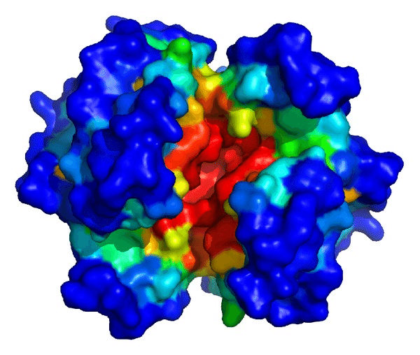
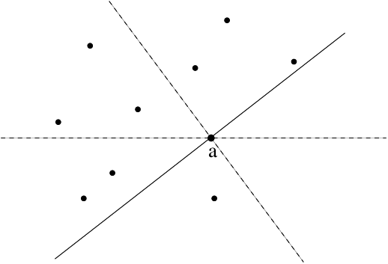
2D Visualisation of Half Space depth
Illustration of half space depth on a protein surface^{[4]}
Finding half space depth in 2D^{[3]}

Slide 6
Methodology
Simulated 10,000 points from both the distributions
Calculated the half space depth for the points for both distributions
Used the sample version of half space depth
Plotted the two depths for a point against each other

Slide 7

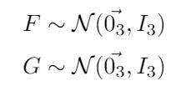
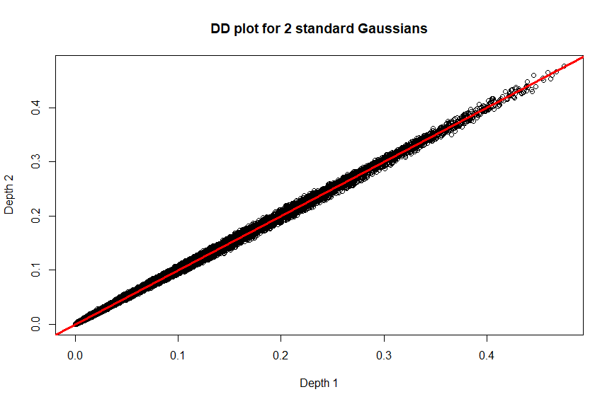
(a)

Slide 8

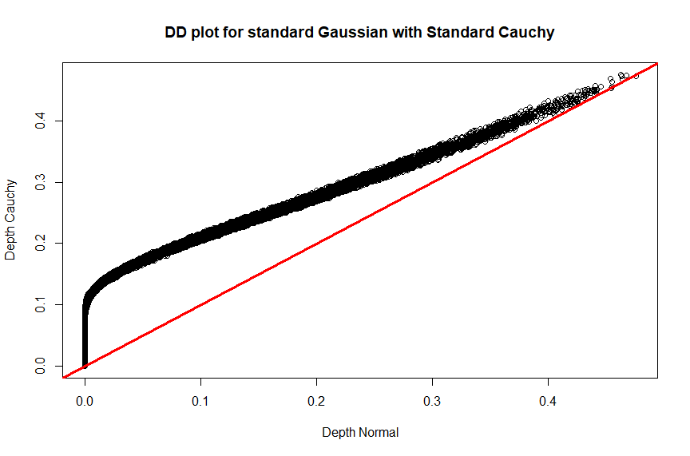
(b)

Slide 9
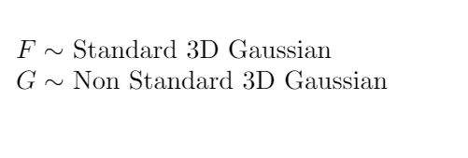
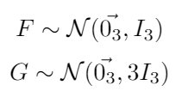
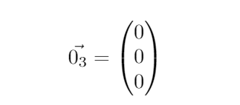
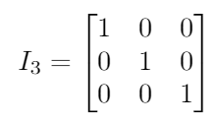
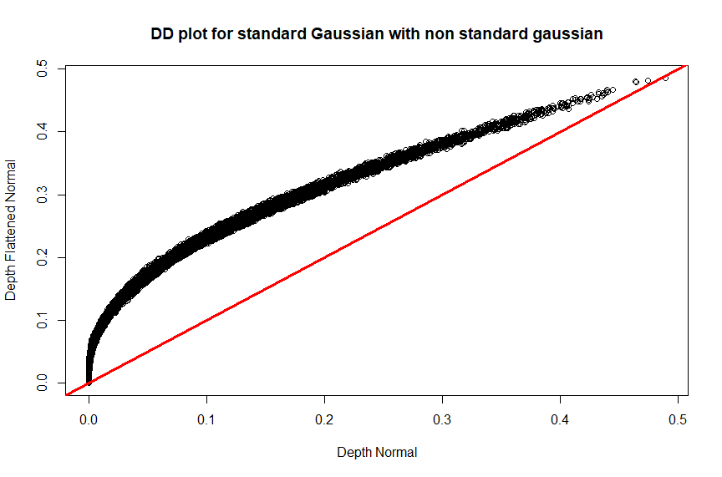
(c)

Slide 10
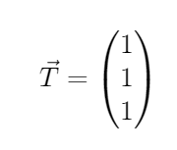
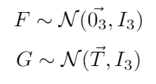
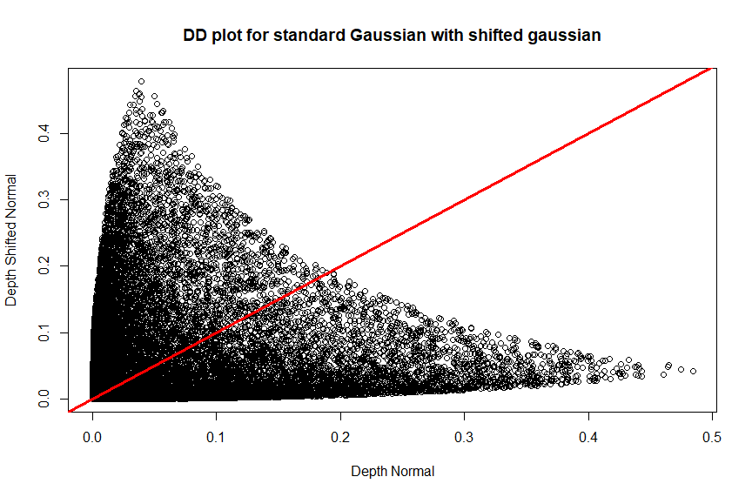
Mean Shifted Gaussian

Slide 11
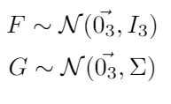
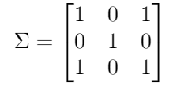
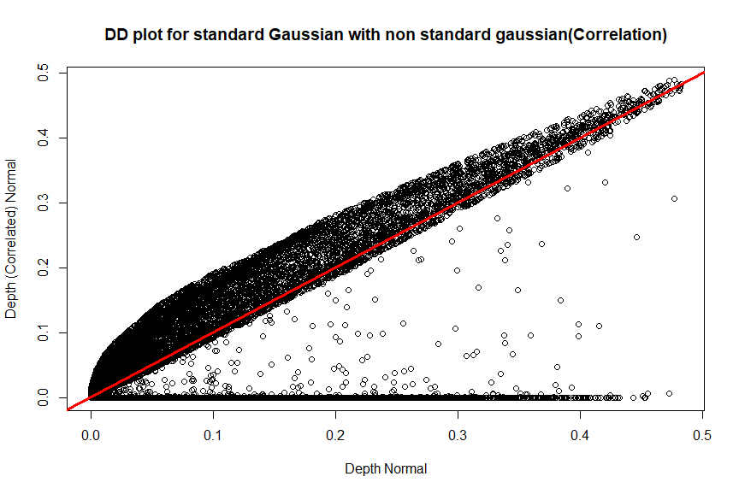
Correlated Gaussian

Slide 12
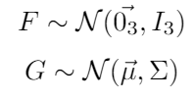
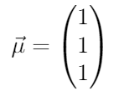
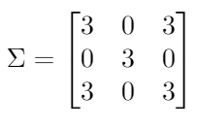
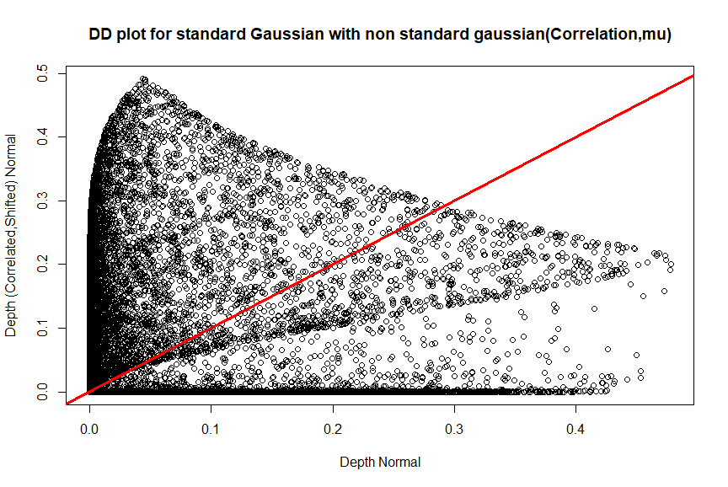
General Gaussian

Slide 13
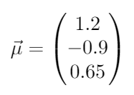
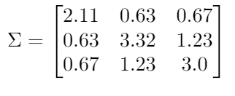
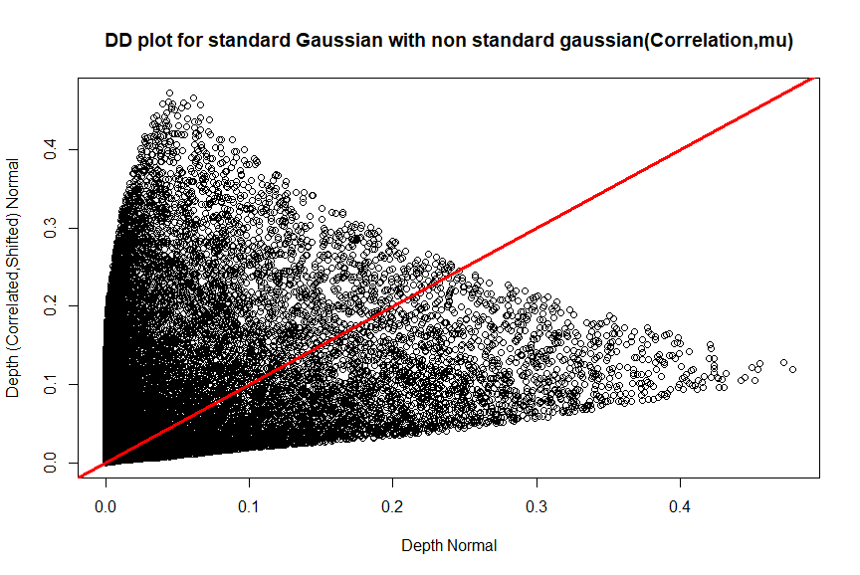
General Gaussian-II

Slide 14
Observations and Results
The DD plot lies on the line y = x if the underlying distributions are the same.
There are some noticeable trends that can be seen on the DD plots
These trends can help us determine some features of the underlying distributions
DD plots are a useful tool to check the nature of the underlying distributions(2 sample problem)
Data depth really characterises the distribution

Slide 15
References
Multivariate Analysis By Data Depth: Descriptive Statistics, Graphics And Inference By Regina Y. Liu, Jesse M. Parelius And Kesar Singh
HW4
Fast Implementation Of Depth Contours Using Topological Sweep, By Kim Miller, Suneeta Ramaswami, Peter Rousseeuw
An Accurate Method for Prediction of Protein-Ligand Binding Site on Protein Surface Using SVM and Statistical Depth Function, By Kui Wang, Jianzhao Gao, Shiyi Sen

Slide 16
Thank You

